Slide 1
How can ‘we lose’ in this environment? Left-wing parties, popular support, and elections.
Francesco Cavatorta
Department of Political Science, Université Laval
E-mail: francesco.cavatorta@pol.ulaval.ca

Slide 2
The Arab Uprisings
The ‘obvious’ starting point for discussing leftist politics in the contemporary Arab world is the Arab Uprisings.
The overwhelming empirical evidence supports the argument that the uprisings were rooted in socio-economic inequalities (Achcar 2013; Teti et al. 2019) rather than in the desire to expand personal freedoms and set up the institutions of democracy.
Ultimately, the disappointment over the inability to introduce radical socio-economic change sapped popular enthusiasm for democracy.

Slide 3
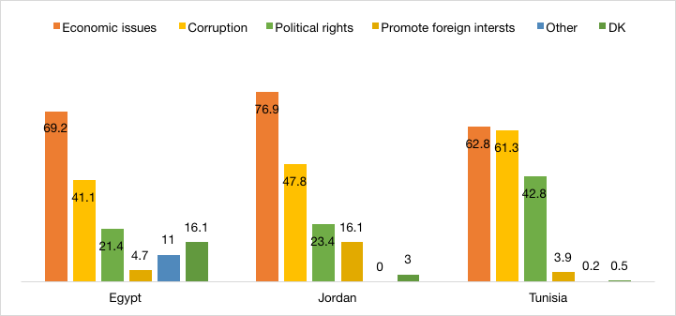

Slide 4
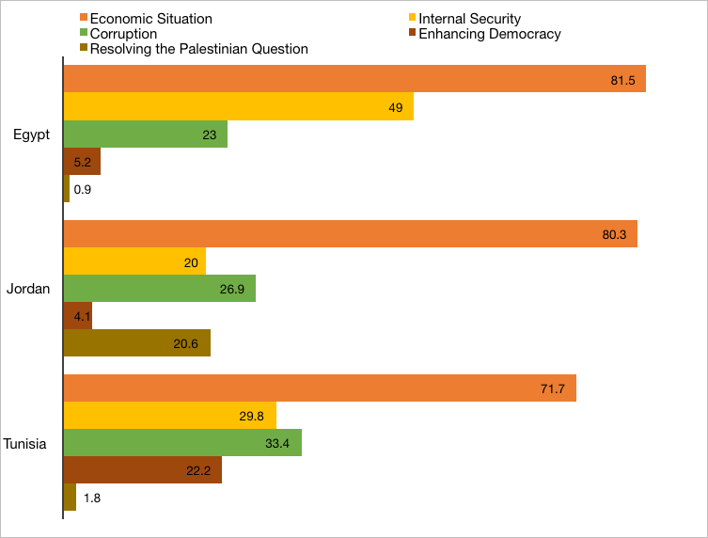

Slide 5
The research puzzle
Why did leftist parties perform so poorly in such a favourable environment?

Slide 6
What is success, what is failure…and what is the left?
When working on political parties, three important definitions need to be put forth:
  Success: a party needs to have a degree of continuous representation in elected institutions, internal structural stability, and the ability to shape policy-making.
  Failure: a party has small and/or intermittent representation in elected institutions, poor internal structural stability, and the inability to affect policy-making
  Left: critically question the main tenets of the social and economic system in place. Class should be among the central tenets of their ideological outlook.

Slide 7
Overview
TUNISIA: Ettakatol (from 20 seats out of 217 in 2011 to virtual disappearance); PCOT/PTT (3 seats in 2011, it joins the Popular Front); Popular Front, an alliance of 12 parties (15 seats in 2014, it splits in 2019 and no seats in 2019)
EGYPT: Taḥaluf al-ṯẖawra mustamirra - The revolution continues (2.8% and 9 seats out of 508). Small parties like the Bread and Freedom party have not been registered after Sisi came to power.
MOROCCO: USFP (39 seats out of 395 in 2011, 20 in 2016 and 34 in 20), Party of Progress and Socialism (12 seats in 2016 and 22 in 2021).

Slide 8
Why so weak?
There is not much research into the ‘failure’ of leftist political parties in the Arab world, but there are several avenues of research that have been explored:
  The legacy of authoritarianism. Unlike Islamists, leftists suffered from the repression of authoritarian regimes. Repression disrupted the organisational capacity of leftist parties and they have yet to recover. Unprepared for post-2011 elections (Resta, 2018; Sellam 2022).
  Co-optation: Fearing the rise of Islamists, leftist parties joined authoritarian ruling coalitions and by doing so they lost ‘the street’.
  The salience of identity. Islamists and leftists do not have significant differences when it comes to the economy, foreign affairs or nationalism. They do when it comes to issues linked to identity politics…and identity is a salient issue for voters when they realise no one can fix the economy (Hopkin 2020).
  Internal rifts. Unlike Islamists, leftists are more prone to splits over issues of personality and ideology, fighting over scarce resources.
  Pool of voters. Leftists and Islamists fish in the same pond (Wegner and Cavatorta, 2019).

Slide 9
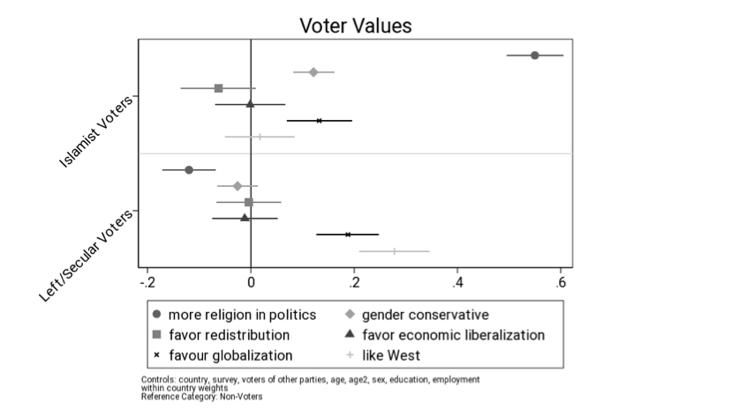
Voter values
Islamist voters "truer" to their parties’ values than Left/Secular voters. The Islamist-Secular divide is mainly about the role of religion in politics, no spill-over to other values.

Slide 10
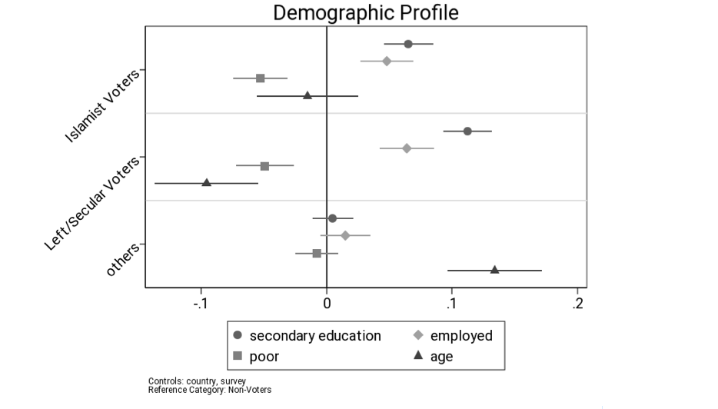
Demographics
Parties have the same demographic profile= educated middle class.

Slide 11
An Arab problem?
The failure of leftist parties in the Arab world should not be seen in geographical isolation. Leftist parties, particularly when they adopt rather strong anti-market economy policy positions, have struggled to have them accepted by the electorate or implement them.
This can lead to explain weakness and failure not only through domestic factors, but international ones as well.
  The end of history argument
  The there is no alternative argument

Slide 12
Conclusion
What does the future hold for the left in the Arab world?
  There are some encouraging signs if one adopts a different definition of success for instance. If success is not equated only with parties doing well at elections on a consistent basis, leftist politics still exists in society (riots, protests, street politics, strikes, labour disputes). Socio-economic inequalities are still driving political and social mobilisation. Identity issues need not to be separate from class issues.
  However, “political parties are the missing link between protest street movements and lasting political reform in the Arab world” (Ottaway, 2021).

